Slide 1
Yogesh’s Data Analysis sql Project data cleaning ,transform and analysis
A Case Study on company employees
Duration: 5-10minutes

Slide 2
Problem statement / Project scope
Our client wants the analysis of their employees in the company
Questions:
What is the gender breakdown in the company ?
What is the race breakdown of employees in the company ?
What is the age distribution of employees in company ?
How many employees work at headqauters vs remote ?
What is the average length of employment for employees who have been terminated ?
What is the gender distribution vary across department ?
What is the gender distribution vary across job title ?
What is the distribution of employees across locations by city?
What is the distribution of employees across locations by state?

Slide 3
Solution approach
There is one table provided which has 22214 rows and 14 columns in it .
MYSQL was the tool used for Analysis and cleaning the data
The data was imported, analysed and transformed as per necessity
Birthdate ,hire_date ,termdate was formatted to right date format for the further analysis
Adding a age column to further do our analysis
KEY SKILLS
Importing data using command line
Data analysis
Data cleaning
Using queries
Exporting data for visualization
Report

Slide 4
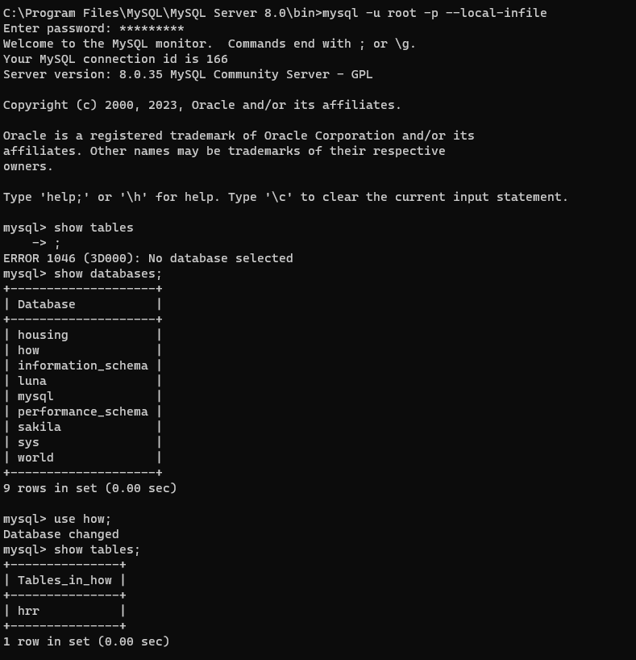
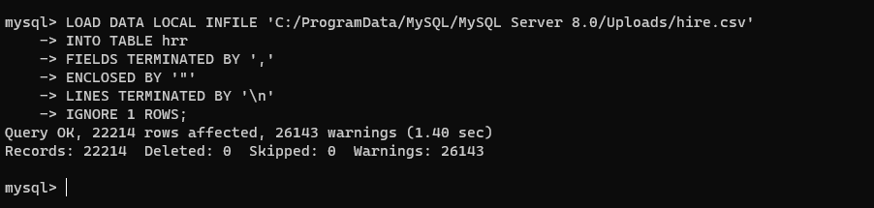
Importing data
As MYSQL takes some time to import large amount of data .We have used command line to import the data using local_infile command in command prompt.

Slide 5
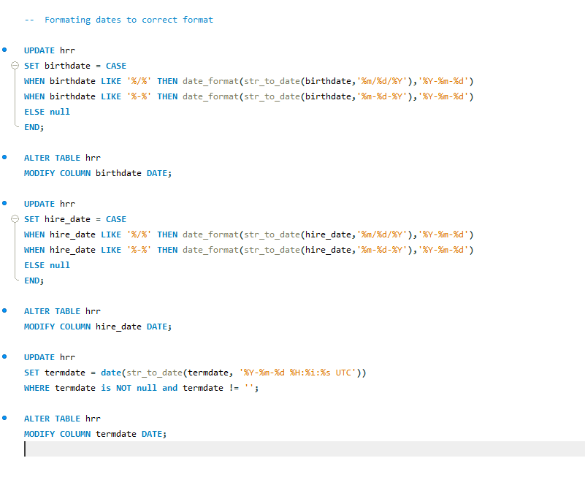
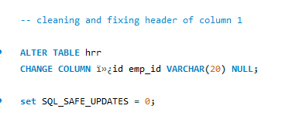
Data transformation/cleaning

Slide 6
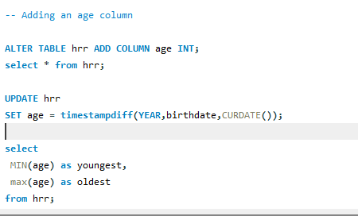
Adding a age column for further analysis
Adding age column and calculating the age
Using timestampdiff function in MYSQL

Slide 7
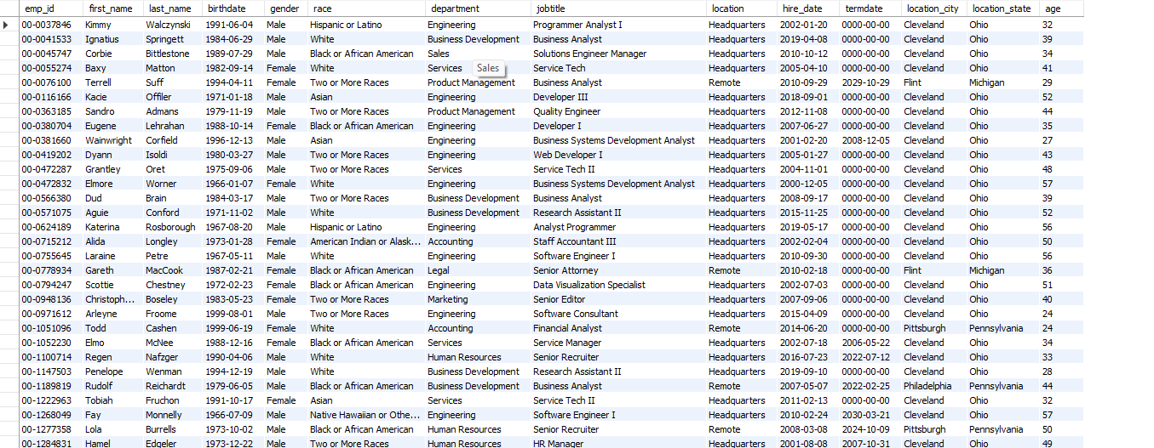
Data transformation

Slide 8
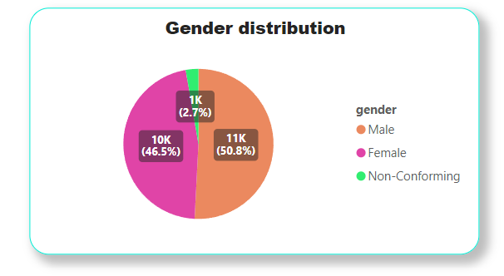
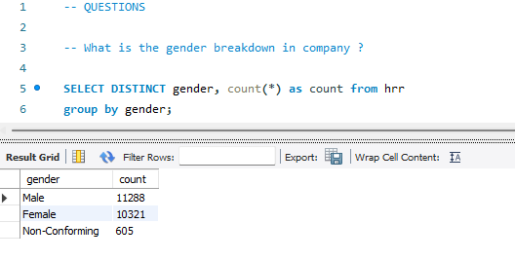
Solution approach
What is the gender breakdown in company ?
From the insight and Pie chart we can say that Male employee is more than Female and Non-conforming.

Slide 9
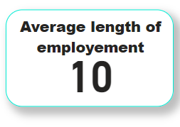
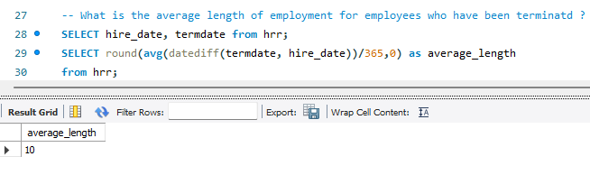
Solution approach
What is the average length of employment for employees who have been terminated ?
The average length of employment for the employees in the company is 10 years .

Slide 10
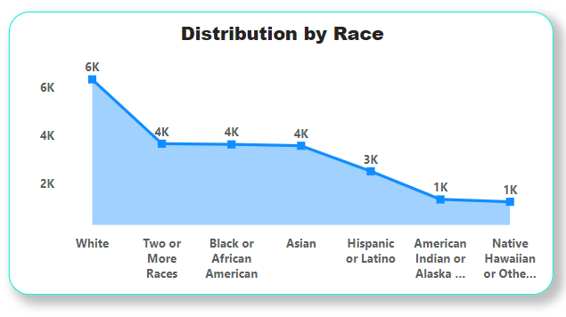
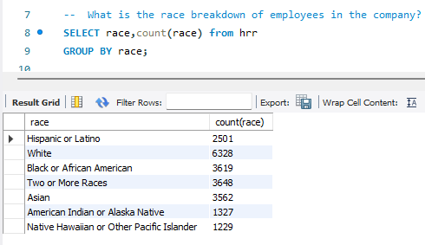
Solution approach
What is the race breakdown of employees in the company?
White peoples are the in the majority in the company .
Native Hawaiian or others are the in the minority in the company .

Slide 11
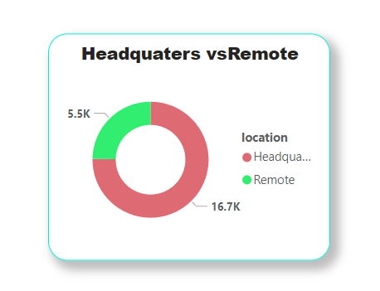
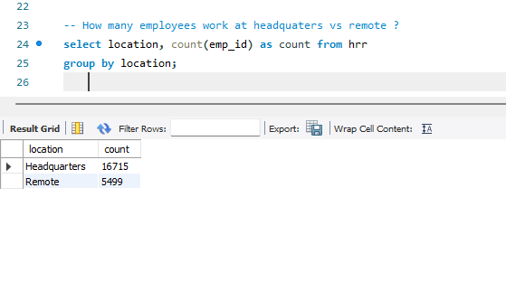
Solution approach
How many employees work at headquaters vs remote ?
Majority of peoples work from headquarters .

Slide 12
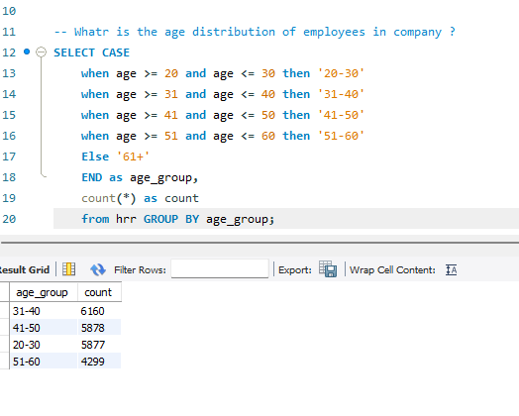
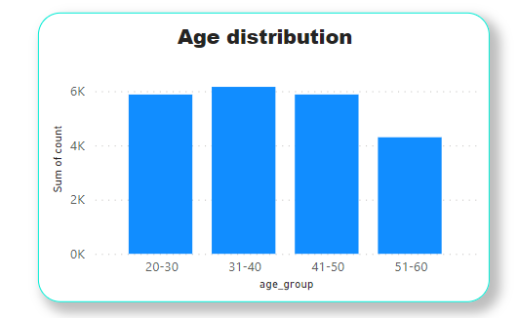
Solution approach
What is the age distribution of employees in company ?
Company consists mainly of employees from age group 31-40
While 51-60 age group employees are the least in the company

Slide 13
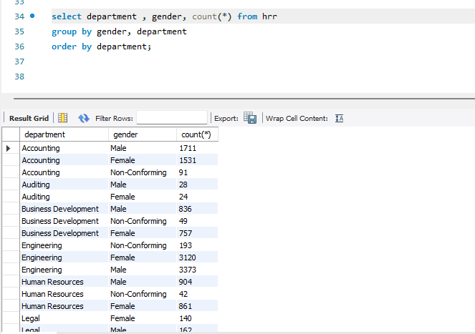
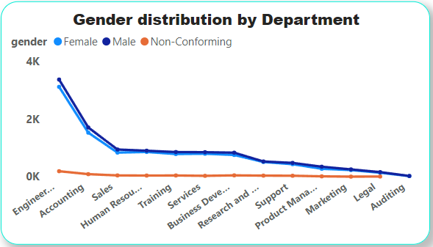
Solution approach
What is the gender distribution vary across department ?
Female and Male are more in each departments compare to Non –Conforming genders.

Slide 14
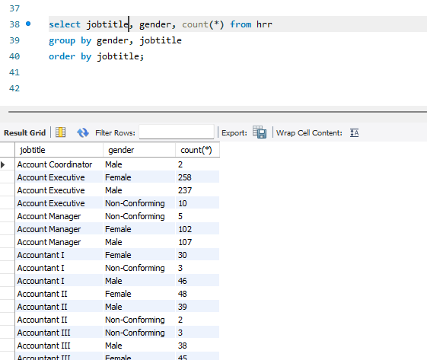
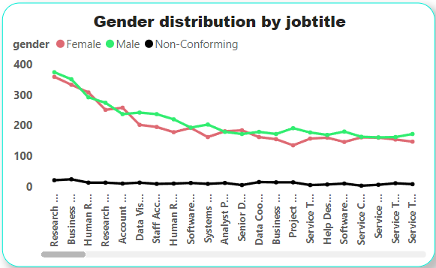
Solution approach
What is the gender distribution vary across jobtitle ?
Female and Male are more in each job titles compare to Non –Conforming genders.

Slide 15
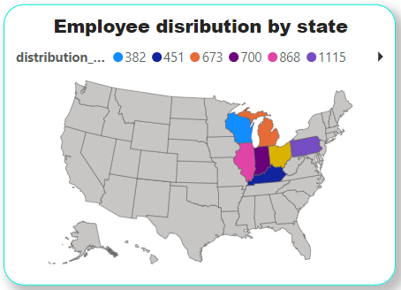
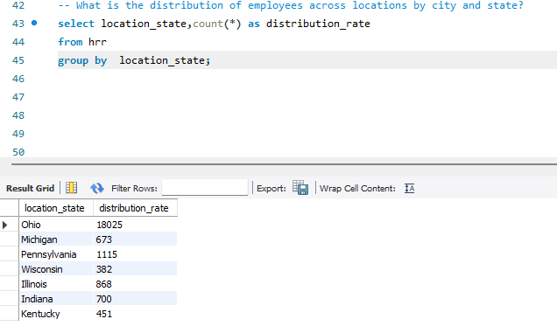
Solution approach
What is the distribution of employees across locations by State ?
Ohio states contains the most employees.
Note : Currently I don’t have a Microsoft business account for power BI so maps won’t display correctly, apologies for the maps.

Slide 16
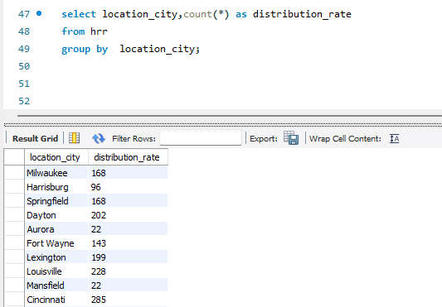
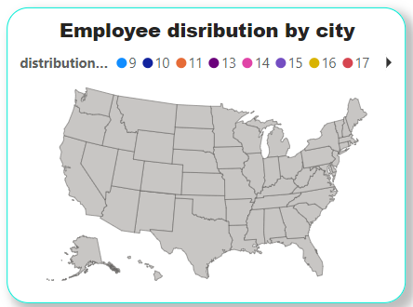
Solution approach
What is the distribution of employees across locations by city ?
Milwaukee city contains the most employees.
Note : Currently I don’t have a Microsoft business account for power BI so maps won’t display correctly, apologies for the maps.

Slide 17
Conclusion
A Report was built for Stakeholders depicting their various questions.
The report was cleaned , transformed and then analyzed to get the relevant answers .
Each Fields were calculated and visual representation were made for better understanding of the analysis.
This report can be used for both high-level and in-depth analysis of Employees.
This report is just a pseudo/sample report and does not contain real information of any company out in the market.

Slide 18
Thank you!

